Slide 1
.NET/C# Training
Parthiban
24/10/2023
Notes:
This template can be used as a starter file for presenting training materials in a group setting.
Sections
Right-click on a slide to add sections. Sections can help to organize your slides or facilitate collaboration between multiple authors.
Notes
Use the Notes section for delivery notes or to provide additional details for the audience. View these notes in Presentation View during your presentation.
Keep in mind the font size (important for accessibility, visibility, videotaping, and online production)
Coordinated colors
Pay particular attention to the graphs, charts, and text boxes.
Consider that attendees will print in black and white or grayscale. Run a test print to make sure your colors work when printed in pure black and white and grayscale.
Graphics, tables, and graphs
Keep it simple: If possible, use consistent, non-distracting styles and colors.
Label all graphs and tables.

Slide 2
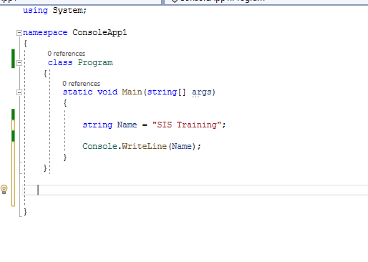
C# Structure – Console Applications
User Defined NameSpace
Predefined NameSpace
Class Name
Program starts
Program Entry point
Program stops
Notes:
Give a brief overview of the presentation. Describe the major focus of the presentation and why it is important.
Introduce each of the major topics.
To provide a road map for the audience, you can repeat this Overview slide throughout the presentation, highlighting the particular topic you will discuss next.

Slide 3
Syntax: NameSpace
namespace namespaceName
{
}
NameSpace
Class 1
Class2
Class 3
Class ..N
namespace namespaceName
{
class class1
{
}
class class2
{
}
}
namespace namespaceName
{
class class1
{
Main(){}
}
class class2
{
}
}
Notes:
Give a brief overview of the presentation. Describe the major focus of the presentation and why it is important.
Introduce each of the major topics.
To provide a road map for the audience, you can repeat this Overview slide throughout the presentation, highlighting the particular topic you will discuss next.

Slide 4
NameSpace
Predefined (System)
User Defined(ConsoleApp)
Notes:
Give a brief overview of the presentation. Describe the major focus of the presentation and why it is important.
Introduce each of the major topics.
To provide a road map for the audience, you can repeat this Overview slide throughout the presentation, highlighting the particular topic you will discuss next.

Slide 5
Amazon
Registration
Login
Cart
Payment
Registration Namespace
Payment
Namespace
Login
Namespace
Cart
Namespace
Class Vendor
ClassCustomer
Notes:
Give a brief overview of the presentation. Describe the major focus of the presentation and why it is important.
Introduce each of the major topics.
To provide a road map for the audience, you can repeat this Overview slide throughout the presentation, highlighting the particular topic you will discuss next.

Slide 6
Namespace
System
Class
Console
Method
WriteLine
Value(Variable Name)
ClassName
Console.WriteLine(Name);
Method Name
Notes:
Give a brief overview of the presentation. Describe the major focus of the presentation and why it is important.
Introduce each of the major topics.
To provide a road map for the audience, you can repeat this Overview slide throughout the presentation, highlighting the particular topic you will discuss next.

Slide 7
string userName = Console.ReadLine();
Namespace
System
Class
Console
Method
WriteLine
Gets the value from User (Keyboard)
ClassName
Console.ReadLine ();
Method Name
Notes:
Give a brief overview of the presentation. Describe the major focus of the presentation and why it is important.
Introduce each of the major topics.
To provide a road map for the audience, you can repeat this Overview slide throughout the presentation, highlighting the particular topic you will discuss next.

Slide 8
Data Types :
Data Type | Size | Description
int | 4 bytes | Stores whole numbers from -2,147,483,648 to 2,147,483,647
long | 8 bytes | Stores whole numbers from -9,223,372,036,854,775,808 to 9,223,372,036,854,775,807
float | 4 bytes | Stores fractional numbers. Sufficient for storing 6 to 7 decimal digits
double | 8 bytes | Stores fractional numbers. Sufficient for storing 15 decimal digits
bool | 1 bit | Stores true or false values
char | 2 bytes | Stores a single character/letter, surrounded by single quotes
string | 2 bytes per character | Stores a sequence of characters, surrounded
Notes:
Give a brief overview of the presentation. Describe the major focus of the presentation and why it is important.
Introduce each of the major topics.
To provide a road map for the audience, you can repeat this Overview slide throughout the presentation, highlighting the particular topic you will discuss next.

Slide 9
Characters
‘A’
String
‘SIS’
“26/10/2023”
Date
1200
‘Integer’
Notes:
Give a brief overview of the presentation. Describe the major focus of the presentation and why it is important.
Introduce each of the major topics.
To provide a road map for the audience, you can repeat this Overview slide throughout the presentation, highlighting the particular topic you will discuss next.

Slide 10
String
‘SIS’
Variable: string
‘SIS’
Name: string
‘SIS’
Notes:
Give a brief overview of the presentation. Describe the major focus of the presentation and why it is important.
Introduce each of the major topics.
To provide a road map for the audience, you can repeat this Overview slide throughout the presentation, highlighting the particular topic you will discuss next.

Slide 11
class classname
{
void Hi()
{
}
void Bye()
{
}
}
class classname
{
Returntype Methodname1()
{
}
Returntype Methodname2()
{
}
}
Returntype
Notes:
This is another option for an Overview slides using transitions.

Slide 12
Atributes:Colour,model,…
Car
Actions:Start ,Stop
Atributes:Colour, skin,breed,..
Animal
Actions:Eat, Walk,Run
Notes:
This is another option for an Overview slides using transitions.

Slide 13
ID,Name,Salary
Employee
Actions:work, walk,eat
Properties
Employee
Actions:Methods/Functions
Notes:
This is another option for an Overview slides using transitions.

